Slide 1
6:-Write a program to implement decision tree in titanic dataset and determine if the model is perfect.

Slide 2

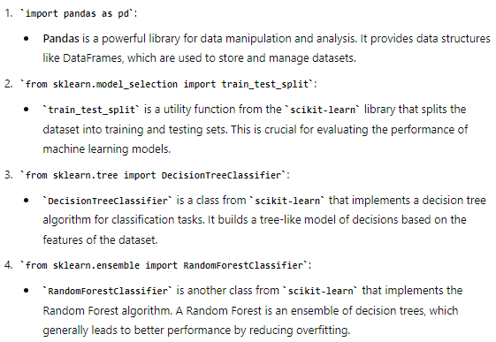
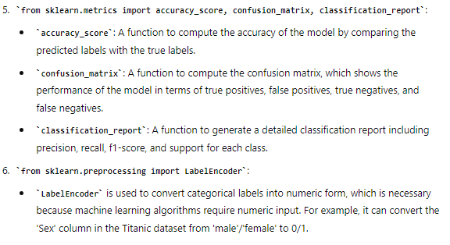

Slide 3




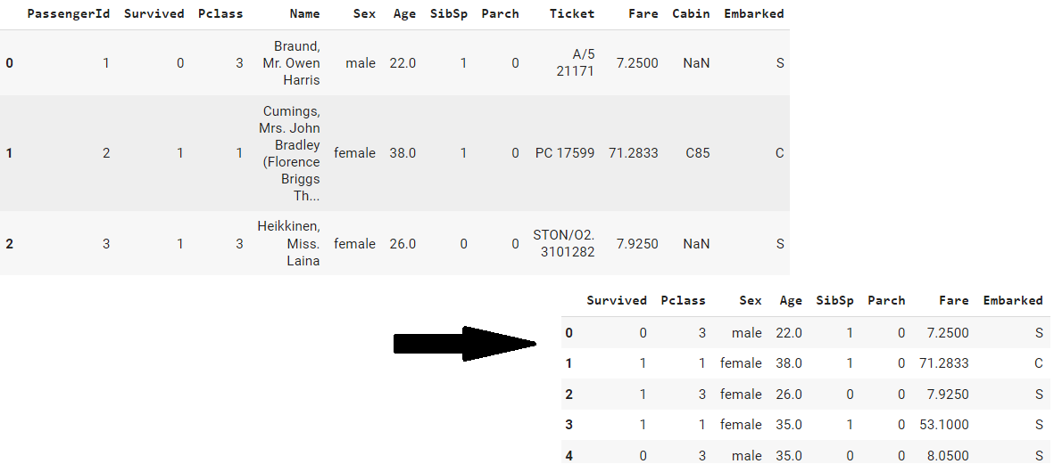

Slide 4


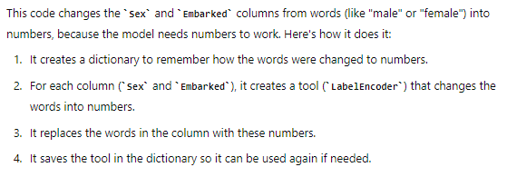

Slide 5



Slide 6

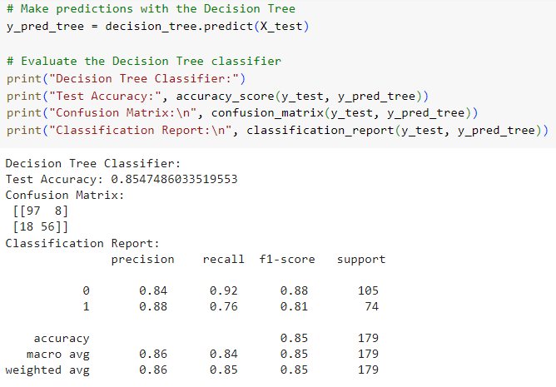

The model needs improvement.

Slide 7




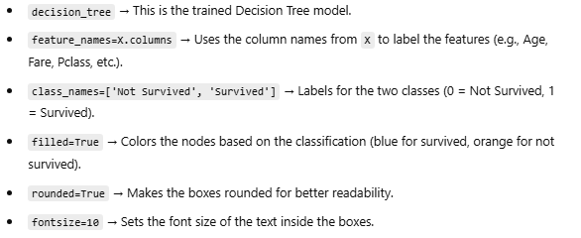

Slide 8
